Slide 1
Project Tips and Guidance
Natural Language Processing

Slide 2
Suggested Readings
Practical Methodology (Deep Learning book chapter)

Slide 3
Project Deliverables

Slide 4
21 Students > 7 Group of 3 members:
Final Project (45%)
Novelty (related work) (20%)
Experiment rigour (comparisons) (20%)
Model complexity (competency) (20%)
Evaluation methods (appropriate) (20%)
Effort (not last day!) (20%)
Submission deliverables:
Python file (e.g., notebook, .py)
Presentation file (e.g., .pdf, .ppt)

Slide 5
Timeline
8 March : Today
10 March : First Group-Meeting
15 March : Recent NLP Trend
17 March : Q&A
22 March : Progress Day
24 March : Progress Day
29 March : Q&A
31 March : Q&A
5 April : Q&A
7 April : Final Project Presentation
12 April : Final Project Presentation
19 April : L18 Knowledge Integration
21 April : L19 Coreference Resolution

Slide 6
Practical Tips

Slide 7
Practical Tips
Pretrained models can help a lot (Huggingface)
Read a lot of papers

Slide 8
Text Summarization

Slide 9
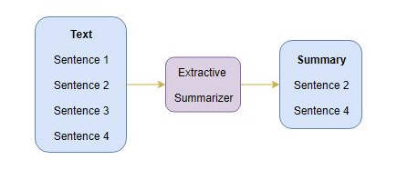
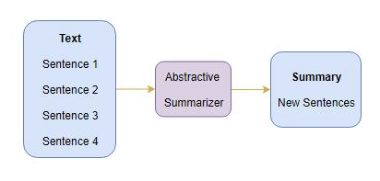
Text Summarization
Extractive
Abstractive

Slide 10
Problems existing in abstractive methods
Model Performance
Factual Inconsistency
Understanding of Models

Slide 11
Model Performance
How to improve distant dependency?
Self attention is computationally expensive O(n2)
How to extend number of input token?
Exploring different types of masking

Slide 12
Factual Consistency Evaluation Metric
How to eliminate Name Entity Hallucinations?
Is n-gram evaluation enough? Misinterpretation?
Factual Inconsistency | Original Summary | Generated Summary
NE Hallucination | Chaky Chong loves NLP | Chaky Lee loves NLP
Misinterpretation | My name is Beau | My name is not Beau

Slide 13
Understanding of Models
Why model performs particularly well on certain samples?
Why model performs particularly poorly on certain samples?
Role of each attention head

Slide 14
Datasets
Xsum
BBC articles (2010 to 2017)
covers a wide variety of domains (e.g., News, Politics, Sports, Weather, Business, Technology, Science, Health, Family, Education, Entertainment and Arts)
Train: 204,045 (90%)
Validation: 11,332 (5%)
Test: 11,334 (5%)
CNN/DailyMail
news stories in CNN and Daily Mail websites
Train: 286,817
Validation: 13,368
Test: 11,487

Slide 15
Papers
Model Performance
Attention is all you need https://arxiv.org/abs/1706.03762
Longformer https://arxiv.org/abs/2004.05150
BigBird https://arxiv.org/abs/2007.14062
T5 https://arxiv.org/abs/1910.10683
Pegasus https://arxiv.org/abs/1912.08777
Factual Consistency
BERTScore https://arxiv.org/abs/1904.09675
FactCC https://arxiv.org/abs/1910.12840
Entity-level https://arxiv.org/abs/2102.09130
SUMMVIS https://arxiv.org/abs/2104.07605
Understanding of Model
Pathology https://arxiv.org/abs/1804.07781
What does BERT look at https://arxiv.org/abs/1906.04341
Knowledge T5 https://arxiv.org/abs/2002.08910
Understanding Multi-Head Attention https://arxiv.org/pdf/1911.03898.pdf
Interpreting Multi-Head Attention https://arxiv.org/abs/2002.07845
Faithfully Interpretable NLP Systems https://arxiv.org/abs/2004.03685

Slide 16
Intent Detection Task

Slide 17
Outline
Why this is important ?
Problem existing these datasets
Model performances
Related works

Slide 18
What is intent detection ?
The automated categorization text data based on intention or aim of that text
Why intent detection task is important ?
In term of industry
Every customer has interactions have a purpose for example, they might want to refund, Downgrade, inscribe, request more information to improve satisfaction of customer from a large amount of query
In term of Academic
There are technical challenges that are bottle neck in dialog system
OOS input typically often happen in production
Semantical similar utterances in-scope classes
Notes:
Explain in general in dialog system how is benefit and this is the bottle neck in dialog system taks
Explain what intent look like

Slide 19
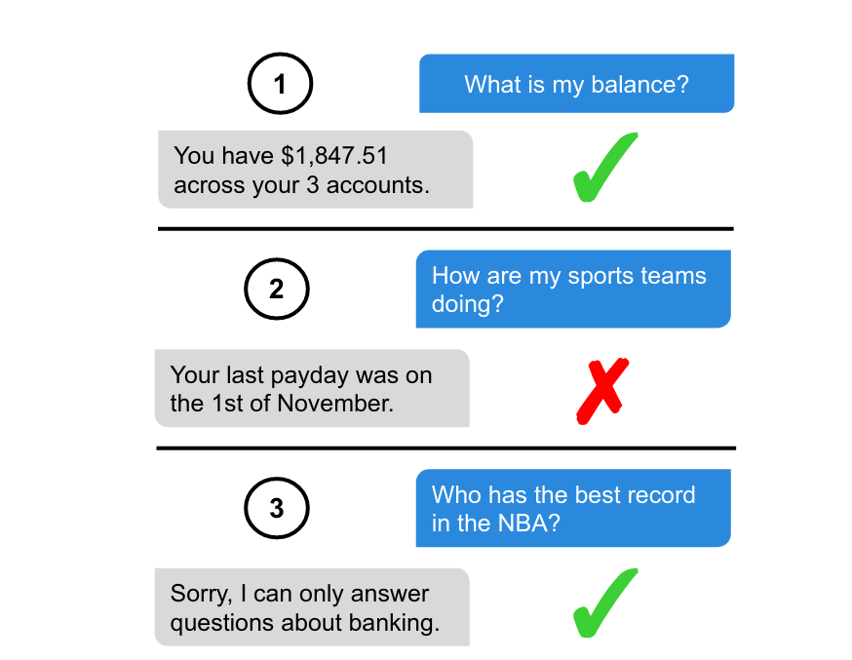
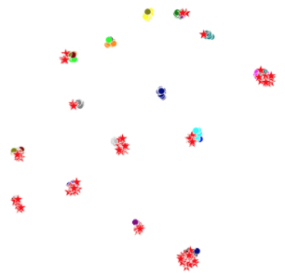

Problems
Example exchanges between a user (blue, right side) and a task-driven dialog system for personal finance (grey, left side)
tSNE of embeddings before their classifier layers are used
https://arxiv.org/pdf/1909.02027.pdf
https://arxiv.org/pdf/2010.13009.pdf
Notes:
Explain the distribution look like the problem of ambiguity on left figure
Explain precision and recall effects of this dataset on right figure

Slide 20
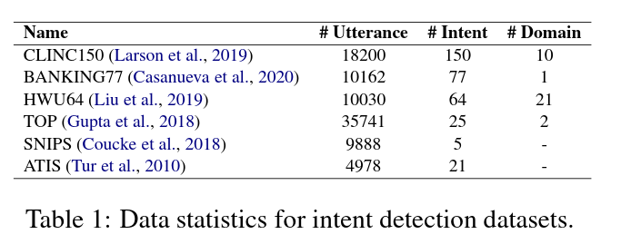
Pre-training Datasets

Slide 21
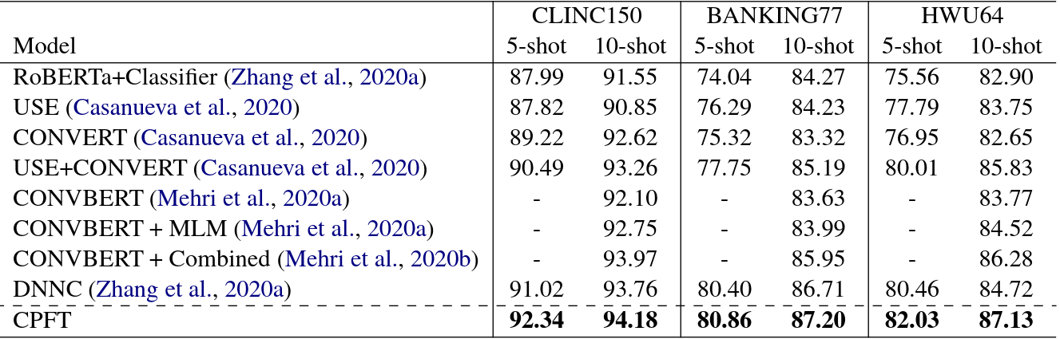
Evaluation Datasets
Table 2: Testing accuracy (×100%) on three datasets under 5-shot and 10-shot settings.

Slide 22
Related Works
Intent Detection
Few-Shot Intent Detection via Contrastive Pre-Training and Fine-Tuning : https://arxiv.org/pdf/2109.06349.pdf
Discriminative Nearest Neighbor Few-Shot Intent Detection by Transferring Natural Language Inference: https://ieeexplore.ieee.org/document/8998086
Efficient Intent Detection with Dual Sentence Encoders : https://arxiv.org/abs/2003.04807
Explainability
What Does BERT Look At? An Analysis of BERT’s Attention: https://arxiv.org/abs/1906.04341
Emergent linguistic structure in Ann trained by self-supervision : https://arxiv.org/abs/1909.02027
Visualizing and understanding Recurrent Networks: https://arxiv.org/abs/1506.0207
Dataset Evaluation
An Evaluation Dataset for Intent Classification and Out-of-Scope Prediction: https://arxiv.org/pdf/1909.02027.pdf

Slide 23
Depression Detection
In Social Media
Notes:
According to WHO Approximately 280 million people in the world have depression, which is about 5 percent of the world’s population
Depression can lead to suicide, so in a way it is a fatal condition.
as we know, nowadays much more people turns to social media to express themselves
So the idea is that if we can detect people or social media posts which indicate depression from their use of language, then, in the future we may be able to create a system that can warn the user
To get a medical health support before their condition get worse

Slide 24
Twitter
Dataset
 | Depression | Control
Number of Posts | 393157 | 3016144
Number of Users | 2198 | 4124
Collection: Take all tweets from 1 month period after the user self-declared that they have been diagnosed with depression (self-declared tweets were removed)
Raw text of each Tweets, User id
Binary Classification / Detection Task
Post-level / User-level
Performance Metrics :
Accuracy, Precision, Recall, F1-score
Dataset Link : https://drive.google.com/drive/folders/1SeRoaKZIJQsyqV28Cli-gOopudBHxHew?usp=sharing
Depression Detection via Harvesting Social Media: A Multimodal Dictionary Learning Solution
Guangyao Shen, Jia Jia, Liqiang Nie, Fuli Feng, Cunjun Zhang, Tianrui Hu, Tat-Seng Chua, Wenwu Zhu
Proceedings of the Twenty-Sixth International Joint Conference on Artificial Intelligence Main track. Pages 3838-3844. https://doi.org/10.24963/ijcai.2017/536
Notes:
Since Depression is a sensitive topic, many of the dataset have very strict data usage agreements
So for the project I have prepared a public dataset which is collected from public tweets in twitter from this paper cited here
The paper collected this dataset automatically from twitter according to some conditions
The condition is that they will use regular expression to find what they call the ‘anchor tweet’ or the tweet that the user declared that they have been diagnosed with depression
Then they will collect all tweets from 1 month period after the anchor tweet
( you might be wondering of the self declared tweets are reliable, and there was a paper that has proven by human judgement that the self declared tweets selected with this kind of regular expression is about 93% valid.)
Next about the dataset we have 2 files for each class, one file is the raw text of the content of all the tweets and the other one is the user id of the user who made the tweets
Our depression detection task is a binary classification or detection task
But you have a choice between user-lever or post-level classification
For example you can classify each tweet according to the user’s class
Or combine all the tweets of one user somehow and classify are the user-level
The main performance metrics that we use in this task is the F1-Score
And others are Accuracy Precision and recall

Slide 25
Performance on this dataset
Year | Title | Model | Performance (User-level)
2017 | Depression Detection via Harvesting Social Media: A Multimodal Dictionary Learning Solution | MDL (Multimodal Dictionary Learning) | F1 = 0.85
2019 | Cooperative Multimodal Approach to Depression Detection in Twitter | COMMA indicator selection GRU + VGG-Net | F1 = 0.90
2020 | SenseMood: Depression Detection on Social Media | BERT + CNN | F1 = 0.93
2021 | DepressionNet: A Novel Summarization Boosted Deep Framework for Depression Detection on Social Media | Stacked_BiGRU + CNN-BiGRU_Att BERT-BART | F1 = 0.912
Notes:
Here are some examples of similar work on the same dataset that I provided
Some of them also collected the corresponding images from the tweets in the dataset then use a multimodal model to classify them
But on this NLP project I would like you to use only text data
As you can see most of them got quite high F1-score at 80-90
But there is an issue on the dataset that i want to bring to light

Slide 26
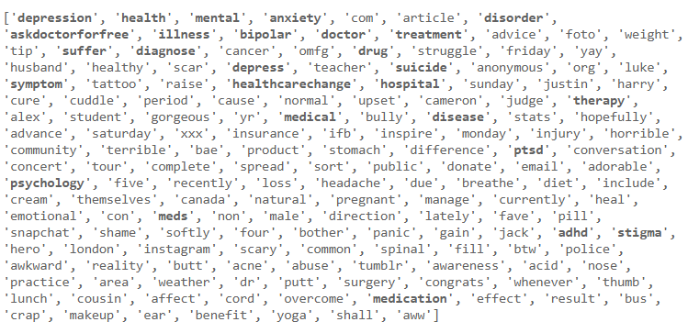
Problems : Mental health-related keywords
List_1 = Top 1000 words from TF-IDF of Depression Class
List_2 = Top 1000 words from TF-IDF of Control Class
List_1 - List_2
Notes:
I have tried doing TF-IDF on the data to see the top 1000 important words from each class
Then find which words are in the depression class but not in the control class
And I found that there are many mental-health related keywords in the depression class as seen in bold
This can happen because when they collected the dataset they just get all the tweets from 1 month period after the anchor tweet without any further filtering on the content
So it might be possible that our model may be memorizing these keywords
While this is good if we want to generally detect depression
But if we want to detect depression from the users’ language pattern alone for example detect depressed user even when they do NOT talk about their condition or they do NOT know that they have depression.
Then having these keywords in our dataset might not be ideal
( and these might be the reason that the previous work on this dataset has high performance )

Slide 27
Problems
Possibility of model just memorizing the keywords
How would the model perform after removing the related words ?
How to avoid memorizing the keywords while maintaining the model’s performance ?
Understanding / Explainability
Why does the model classify a specific user/post as Depression ?
What are the language patterns of depression detected by the model ?
Many Posts per one user, are ALL of them important ? (for user-level)
How to select only the important parts ?
Class imbalance : Control >> Depression
How to make the model more robust to imbalance data ?
etc.
Notes:
To conclude, I have listed some of the remaining problems in depression detection task here

Slide 28
Related Works
Depression Detection in Social Media
Depression Detection via Harvesting Social Media: A Multimodal Dictionary Learning Solution : https://doi.org/10.24963/ijcai.2017/536
MGL-CNN: A Hierarchical Posts Representations Model for Identifying Depressed Individuals in Online Forums : https://ieeexplore.ieee.org/document/8998086
Monitoring Depression Trends on Twitter During the COVID-19 Pandemic: Observational Study : https://arxiv.org/abs/2007.00228
DepressionNet: A Novel Summarization Boosted Deep Framework for Depression Detection on Social Media : https://arxiv.org/abs/2105.10878
SenseMood: Depression Detection on Social Media : https://dl.acm.org/doi/abs/10.1145/3372278.3391932
Explainabitilty
Towards Explainability in Using Deep Learning for the Detection of Anorexia in Social Media : https://www.ncbi.nlm.nih.gov/pmc/articles/PMC7298178/
Removing Keywords
Detecting Linguistic Traces of Depression in Topic-Restricted Text: Attending to Self-Stigmatized Depression with NLP : https://aclanthology.org/W18-4102
Selective Masking in MLM
MASKER: Masked Keyword Regularization for Reliable Text Classification : https://arxiv.org/abs/2012.09392
Train No Evil: Selective Masking for Task-Guided Pre-Training : https://arxiv.org/abs/2004.09733
Knowledge Enhanced Masked Language Model for Stance Detection : https://aclanthology.org/2021.naacl-main.376

Slide 29
Link to Group Selection
https://docs.google.com/spreadsheets/d/14ae6l_vtIjDQDcLL99bws28yyHHJPtNSuNbrtoJbhyI/edit?usp=sharing

